Slide 1
Mask Detection System
Team : ABC
Members : 조민우, 이준영, 최난경
1/22

Slide 2
CONTENTS
1. Introduction
2. Data
3. Workspace
4. Models
5. Result
6. Disscusion
2/22

Slide 3
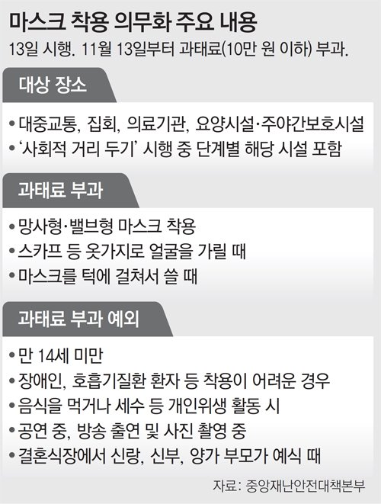
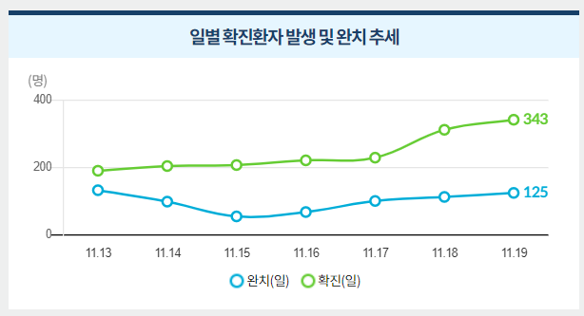
1. Introduction
코로나(COVID19) 로 인해 외출 시 마스크 착용의 의무화.
꾸준히 늘어나는 바이러스 확산을 방지하기 위해 마스크 착용 판별이 필수적임.
3/22

Slide 4
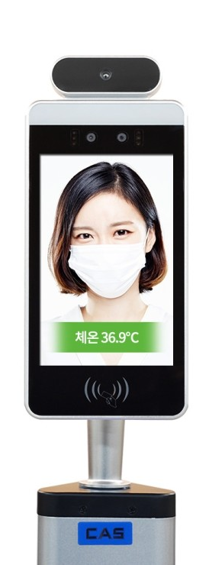
1. Introduction
발열체크기는 상용화가 되었지만 마스크 착용 검사는 여전히 없다.
추가적인 마스크 판별기를 제작 보급하기엔 비용과 시간이 많이 소모될 것으로 예상.
안면인식툴(Res10_300x300_ssd_iter_140000.caffemodel) 과 결합하여 마스크 판별 툴을 만들고 발열체크기와 결합한다면 발열과 마스크 유무를 동시에 판단이 가능함.
마스크 O
Mask detection model
4/22

Slide 5
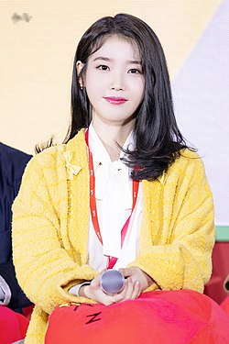
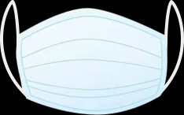
2. Data
Mask Dataset in Github (https://github.com/prajnasb/observations.git)
얼굴영역 인식
OpenCV 및 NumPy
슬라이싱으로 얼굴 ROI를 추출
얼굴의 위치를 기억하여
원래 얼굴 ROI에 자동으로
오버레이 됨
Dlib를 사용하여 얼굴 랜드 마크를
감지하여 얼굴에 마스크를 배치 할 위치
측정
5/22

Slide 6
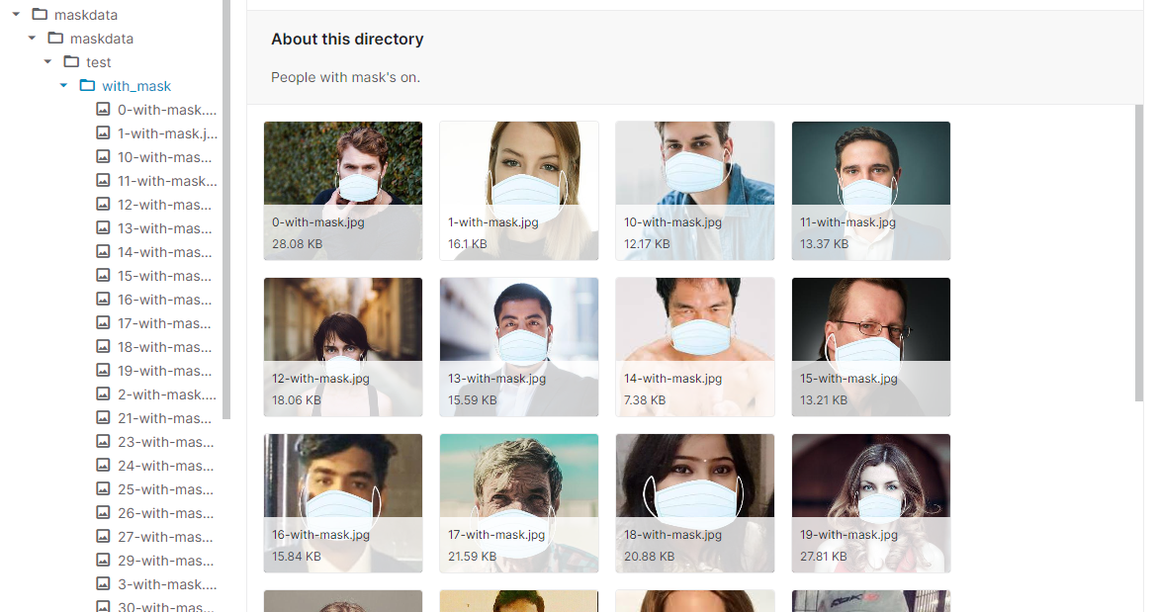
2. Data
Use Kaggle Dataset
Mask : 3,725
No_Mask : 3,828
Train : 75%
Test : 25%
6/22

Slide 7
3. Model
Face Detection
Res10_300x300_ssd_iter_140000
Mask Detection
abcNet
7/22

Slide 8
3. Model
Face Detection
res10_300x300_ssd_iter_140000.caffemodel
It is a Caffe model which is based on the Single Shot-Multibox Detector (SSD) and uses ResNet-10 architecture as its backbone. It was introduced post OpenCV 3.3 in its deep neural network module.
8/22

Slide 9
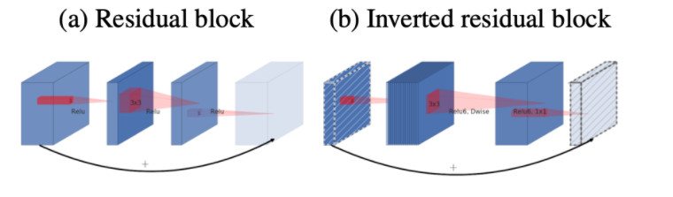
3. Model
Mask Detection
Using MobilNetV2
Inverted Residuals and Linear Bottlenecks
Convolution Channel
Inner block Channel
Loss : Binary Cross Entropy
Optimizer : Adam
Epochs = 20 , Batch Size = 32
9/22

Slide 10
3. Model
Training
Dataset
Mask detection
Github Dataset
MobilNetV2
Kaggle Dataset
ImageDataGenerator
Epochs = 20 , Batch Size = 32
Face Detection
SoftMax
Pre-trained Res10_300x300_ssd_iter_140000.caffemodel
Loss : Binary Cross Entropy
Optimizer : Adam
10/22

Slide 11
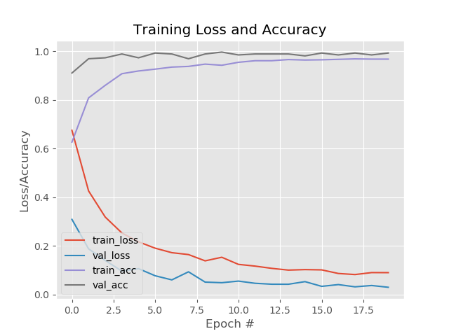
4. Result
Result with Github Dataset
Good Performance of
Accuracy and Loss
Accuracy : ~ 0.99
Loss : ~0
11/22

Slide 12
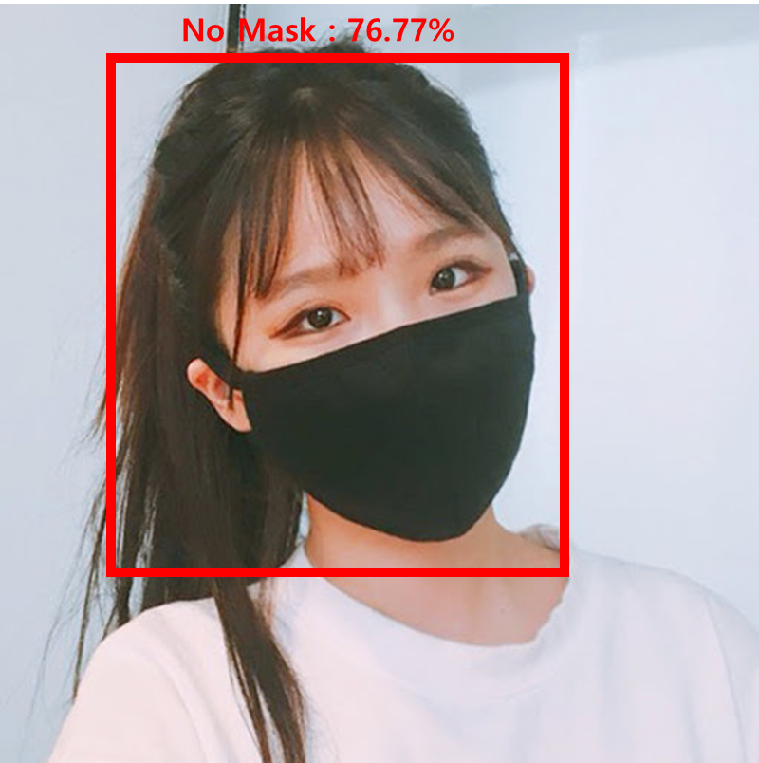
4. Result
Result with Github Dataset
The Model can’t detect the black Mask.
Kaggle Dataset (contain the black mask)
12/22

Slide 13
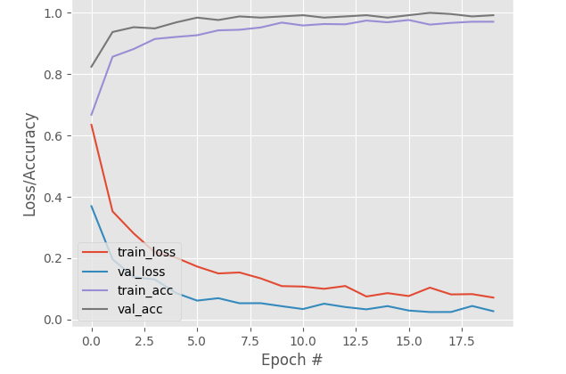
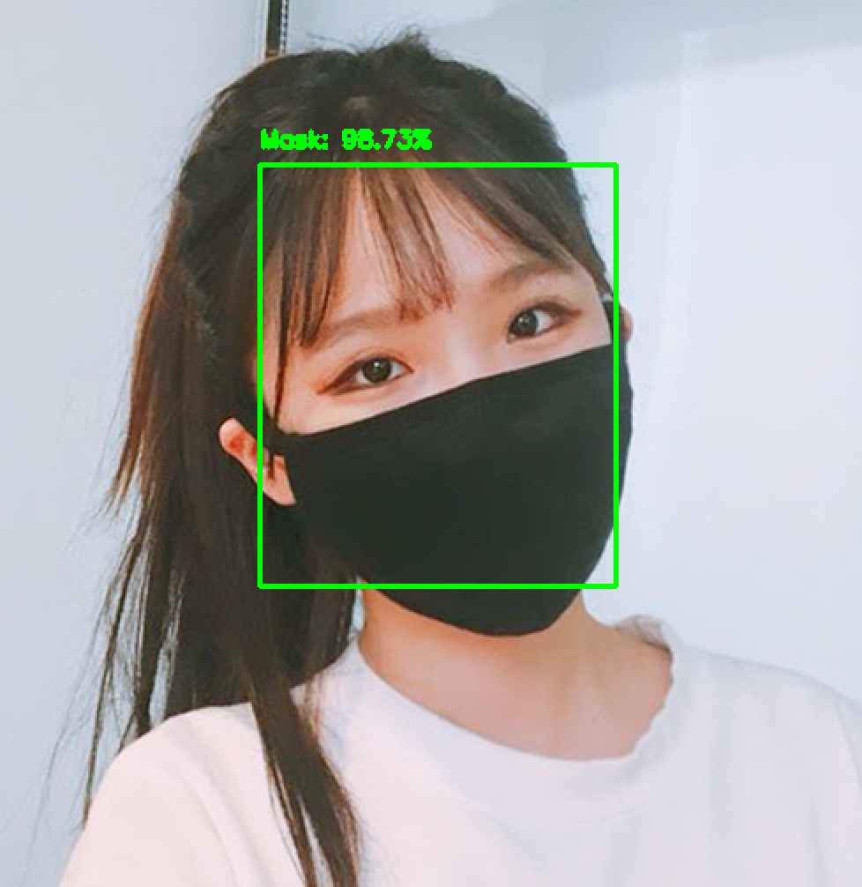
4. Result
Result with Kaggle Dataset
Training Loss and Accuracy
Good Performance of
Accuracy and Loss
Detect Black Mask
13/22

Slide 14
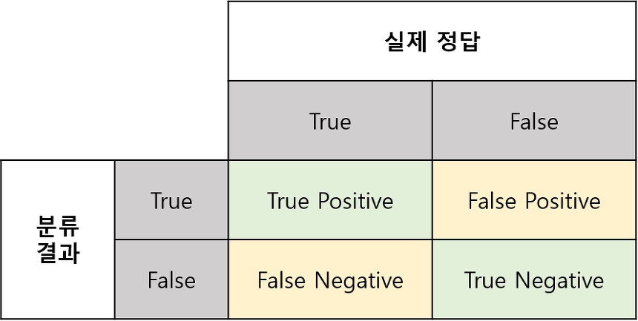




4. Result
Result with Kaggle Dataset
Skill score
Accuracy : 0.99
Precision : 0.99
Recall : 0.94
F1-score : 0.96
Accuracy = $\frac{TP+TN}{N}$
Recall = $\frac{TP}{TP+FN}$
TP
FP
Precision = $\frac{TP}{TP+FP}$
F1 score = 2 *$\frac{Precision ∗Recall}{Precision+Recall}$
FN
TN
14/22

Slide 15
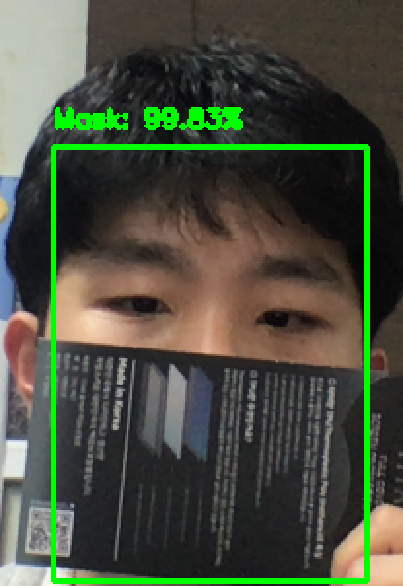
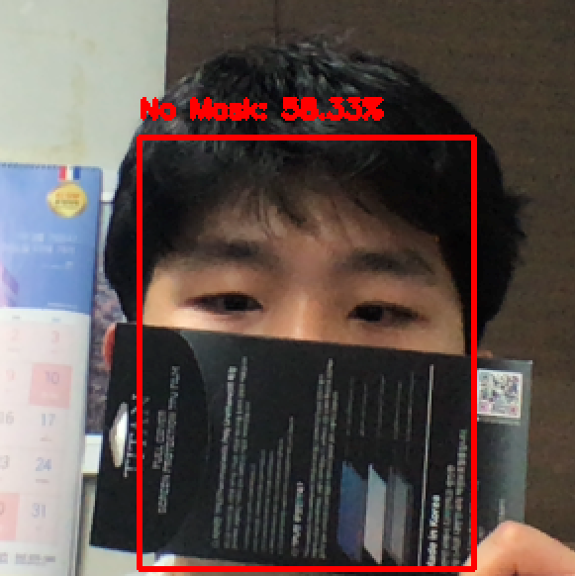
5. Discussion
Add Data
Data With several type of mask
Model detect anything blinding the face as mask.
Model with Kaggle Dataset
15/22

Slide 16
5. Conclusion
1. We make the mask detect with ResNet.caffeModel using MobilNetV2.
2. Using github data, Model can’t detect black mask.
3. With Kaggle data, Model can detect black mask and have high skill score.
4. We will try to apply this model to Webcam ( at the presentation talk)
16/22

Slide 17








6. Fin.
Thank You !!
17/22

